Slide 1
Security Architecture, Models and Security Kernel
Lec Asad Raza

Slide 2
Readings
CISSP – Chapter 5
Dieter and Gollman – Chapter 5

Slide 3
Overview
We will examine the different protection mechanisms of a computer and an operating system.
We will also look at how operating systems and products are evaluated under different standard criteria.

Slide 4
System Components
The processor, the brain of the computer, processes the instruction set and data that is passed to it.
Applications and operating systems are compiled sets of instructions the processor uses to process data.

Slide 5
System Components: Control Unit
All applications, processes, services and threads use the same processor through time slicing.
Control Unit ensures that all the applications and OS get their time slice.

Slide 6
System Components: Registers
Registers are temporary holding spaces for memory addresses of instructions and data that need to be worked on.

Slide 7
System Components: ALU
The ALU processes data by carrying out mathematical functions and performing logical functions.

Slide 8
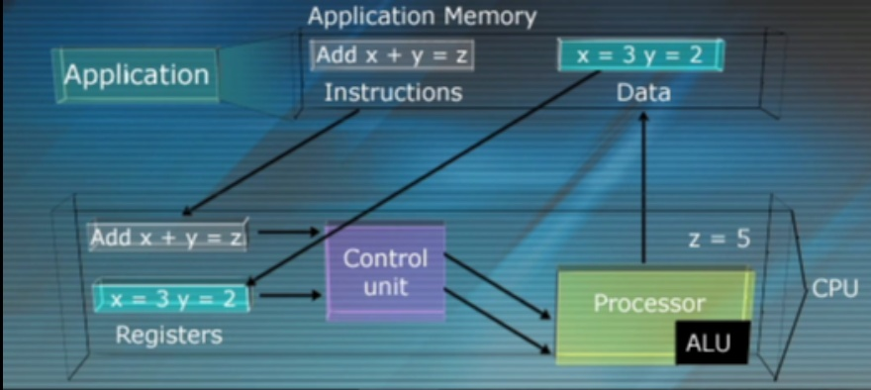
System Components

Slide 9
Storage Types
Primary
Secondary
Volatile
Non-volatile

Slide 10
Memory types
RAM :
Volatile memory
You have to consider the issues of integrity and confidentialty
DRAM and SRAM
ROM
Good for storing parts of OS .
Data cannot be altered
Confidentiality issues
Software Stored on ROM chips is called firmware
EPROM
Can be erased and modified electronically
May be used for storing keys or parts of OS

Slide 11
System Protection Mechanisms
A computer and operating system have several different ways to protect itself from applications and users.
An operating system is a working environment for applications and users and must protect itself and its entities.

Slide 12
Software Components: Processes & Threads
Process:
Set of instructions actually running
When a process is created , OS assigns resources to it
Collection of instructions and resources is called a process
E.g. displaying data, spooling print jobs, saving data
Process works in its own address space
Communicates with other processes through operating system

Slide 13
Process Management
Collection of instructions and resources
Multiples processes are handled through multiprogramming or multitasking
Different OS work with different process models
E.g. Linux uses forking (creating child processes)
OS keeps a process table which has one entry per process
When process’s interrupt is called, its data is passed to the multitasking time sliced processor.
When the processor is finished with a process’ data, the result is passed back to process’ memory segment.
Processes in waiting state, not carrying out any activity, are eating up system resources.

Slide 14
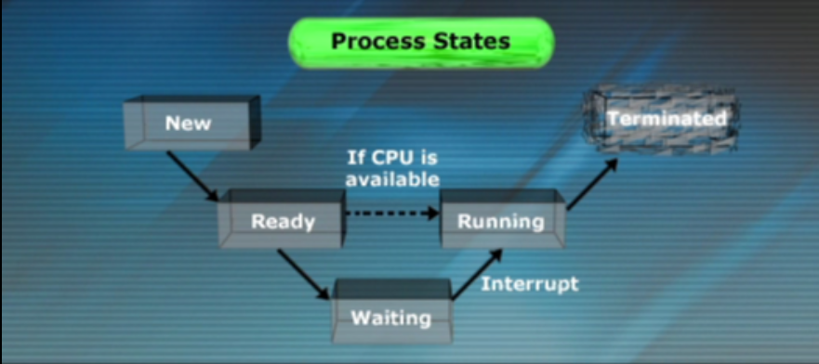
Processes states

Slide 15
Security in Processes
Processes share the resource like memory, data files etc
Process should not read or write the items at the same time
Operating System implements Process isolation techniques
In Process isolation of one program hangs , others are not affected
Methods of Process Isolation
Encapsulation of Objects (data/code hiding)
Time multiplexing (sharing same resource)
Naming distinctions (PID)
Virtual mapping (allows different processes to have their own address space )

Slide 16
Threads
Thread:
An instruction set within a process
One process can have many different functionalities, which are usually carried out by threads.
An Operating system can handle requests from several different threads at the same time
When a process needs to send something to the CPU for processing , it generates threads
Threads are dynamically created an destroyed

Slide 17
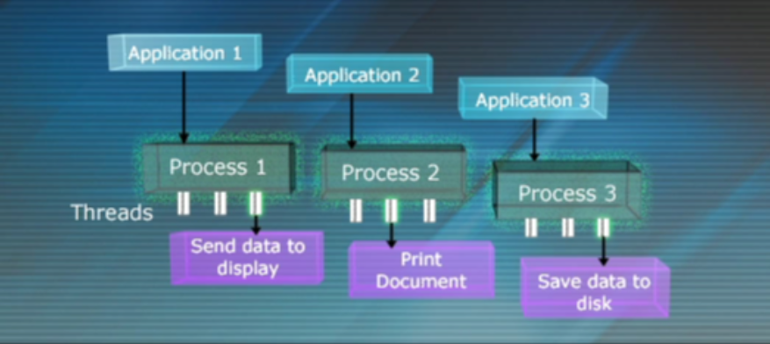
Processes & Threads

Slide 18
System Memory
Memory Mapper: Part of operating system that keeps track of memory segments assigned to processes.
The operating system must ensure that processes interact with their memory segments properly.
Application communicate with their assigned memory segments through memory mapper.
The processor has physical data buses directly connected to the computer’s memory chips.

Slide 19
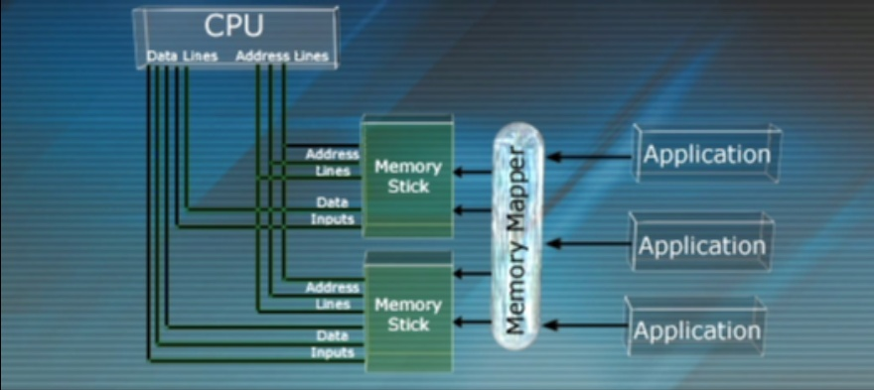
System Memory

Slide 20
How does it work ?
Thread needs an instruction executed and provides a logical address.
The request and address go to Memory Manager
Memory manager maps the logical address to an absolute address
Absolute addresses are loaded into CPU registers

Slide 21
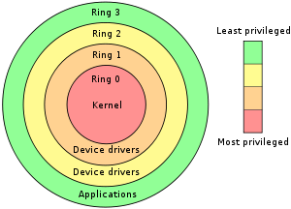
Rationale
A security mechanism in an given layer can be compromised if an attacker gets into the layer below
Putting Security mechanisms into the core of a System reduces the overheads caused by Security

Slide 22
Operating System Integrity
Reference Monitor
An access control concept that refers to an abstract machine that mediates all the access to objects by subjects
Security Kernel
Hardware , software and firmware of a trusted computing base (TCB) that implements the Reference monitor concept
Trusted Computing Base
The totality of protection mechanisms within a computer system
Includes Hardware, software, firmware
Includes components that enforce the security policy

Slide 23
Operating System Integrity
RULE : Users must not be able to modify the operating system
Users should be able to invoke the Operating System
Users should not be able to misuse the Operating System
What is required to achieve these goals ?
Status Information
Controlled Invocation

Slide 24
Modes of Operation
OS should differentiate between computations on behalf of user and on behalf of operating system
Status flag is used for this purpose
Motorolaa 68000: one bit used to distinguish between “user mode” and “supervisor mode”
Intel 80386: Two status bits results in four modes
Unix operating system distinguish between “root” and “user mode”
Why are these modes important ?

Slide 25
Controlled Invocation
Processors deal with interruptions of executions created by errors, user request , hardware failure etc
This mechanism is called exception , interrupts , traps etc
A trap includes an address called “interrupt vector”
interrupt vector is located in “interrupt vector table”
Vector table gives the location of “interrupt handler” in memory
Improper handling of interrupts may cause security issues
Example of interrupt CTRL+C

Slide 26
Protection on Motorola 6800
16 bit processor with 16-bit status register
System byte contains the bits relevant to security controls
T > Trace bit , position 15
S > Supervisor bit, position 13
I2,I1,I0 > Interrupt level number, position 8 to 10
After reset 68000 always boots in supervisor mode
It remains in user mode
Only interrupts or exceptions can switch S bit from 0 to 1
Operating system calls are implemented via TRAP#n
RTE instruction is used to call back switch to “0” again
Function code outputs FC2,FC1,FC0

Slide 27
Protection on Intel 80386/486
32 bit microprocessors
2-bit field in status register defines 4 privilege levels
Software's could be assigned to these levels
0 Operating system kernel
1 Rest of operating system
2 I/O drivers etc
3 Application Softwares
Unix uses only two levels 0 & 3
Information of system objects is stored in descriptors
Descriptors are stored in descriptor table
Descriptors are accessed via selectors

Slide 28
Privilege level of an object is stored in the DPL field of its descriptor
Selector
16-bit field
Contains index pointing to objects entry in table
Contains requested privilege level (RPL)
When a subject request access to object, relevant selectors are loaded in dedicated segment registers

Slide 29
Problem
Managing access to operations require higher privileges
This problem is solved using gates in 80386
Gate is a system object that points to a procedure (in some code segment)
Gates allow execute-only access to a procedure in the inner ring
By allowing outer-ring procedures to call inner-ring procedures creates potential security threats
Copying an object residing in the inner-ring
RPL field in the selector solves this problem

Slide 30
QUESTIONS ?

